Slide 1
ME 270
Manufacturing Technology
Lecture 2: Processing and the Mechanical and Physical Properties of Materials
S. Boahen (PhD)

Slide 2
Course Content
Introduction to manufacturing
Connection between processing and the mechanical and physical properties of materials
Casting and moulding processes
Fundamentals of welding
Material removal processes
Introduction to support functions in manufacturing
Introduction to computer aided manufacturing

Slide 3
Lesson Objectives
At the end of the lesson, students should be able to
Classify engineering materials
Explain mechanical properties of materials
Explain the physical properties of materials
Explain how material properties affect manufacturability

Slide 4
Classification of engineering materials
Engineering materials can be classified into
Metals and alloys
Ceramics and glasses
Polymers
Composites

Slide 5
Metals and alloys
They are inorganic materials composed of one or more metallic elements.
Properties
They have a crystalline structure and are good thermal and electrical conductors
Many metals have high strength and high elastic module
They maintain their good strength at high and low temperatures.
They also have sufficient ductility, which is important for many engineering applications.
They can be strengthened by alloying and heat treatment.
They are less resistant to corrosion

Slide 6
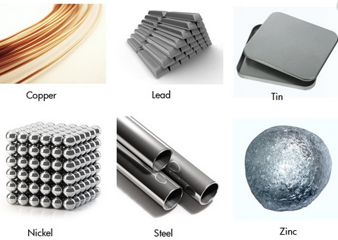
Metals and alloys

Slide 7

Ceramics and glasses
They are inorganic materials consisting of both metallic and non-metallic elements bonded together chemically.
Properties
They can be crystalline (ceramics), non-crystalline (glasses) or mixture of both (glass-ceramics)
Generally they have high melting points and high chemical stabilities.
They have high hardness, high moduli and high temperature strength
They are very brittle and cannot be used as good metals
Ceramics are usually poor conductors of electricity
Ceramics have a high strength on compression

Slide 8
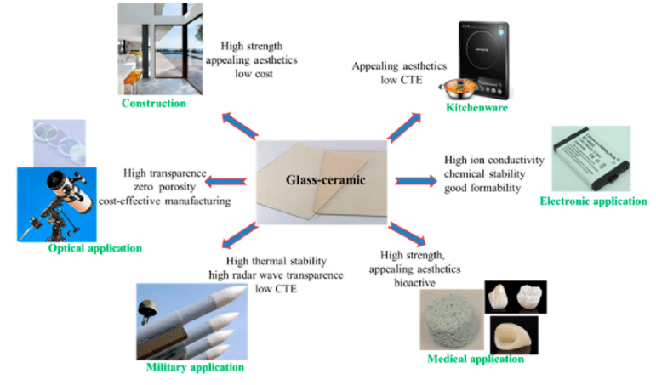
Ceramics and glasses

Slide 9
Polymers
Organic materials which consist of long molecular chains or network containing carbons
Properties
Most polymers are non-crystalline, but some consist of mixtures of both crystalline and non-crystalline regions.
They generally have low densities and low rigidity.
Their mechanical properties may vary considerably.
Most polymers are poor conductors of electricity due to the nature of the atomic bonding
Most of them are corrosion resistant, but cannot be used at high temperatures
They generally have a good strength to weight ratio

Slide 10
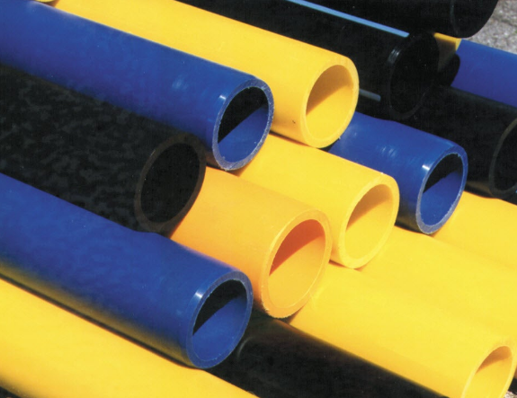

Polymers

Slide 11
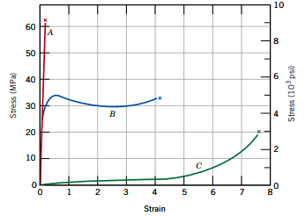
Stress-strain behaviour of polymers
Polymers can be classified as brittle, plastic and highly plastic.
Polymers are neither as strong nor as stiff as metals.
However, their high flexibilities, low densities, and resistance to corrosion make them the materials of choice for many applications.
The mechanical properties of polymers are sensitive to changes in temperature and strain rate. With either rising temperature or decreasing strain rate, modulus of elasticity diminishes, tensile strength decreases, and ductility increases.

Slide 12
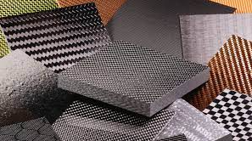
Composites
Materials that consists of two or more metals, alloys, plastics and polymers.
Properties
They usually consist of a matrix and a reinforcement.
They are designed to combine the best properties of each of its components.

Slide 13
Properties of engineering materials
Engineering materials have property profiles
The properties of engineering materials can be classified as physical, mechanical and chemical.
Properties such as density, cost and anisotropy are other properties of engineering materials.

Slide 14
Mechanical properties of materials
Tensile Strength
Toughness
Malleability
Hardness
Ductility
Stiffness
Brittleness
Elasticity
Plasticity
Creep
Fatigue

Slide 15
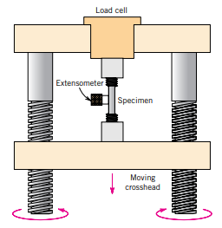

Tension Test
Procedure
A material is gripped at both ends by an apparatus, which slowly pulls lengthwise on the piece until it fractures.
The pulling force is called a load, which is plotted against the material length change, or displacement.
The load is converted to a stress value and the displacement is converted to a strain value.
Fig. Tensile
stress-strain Test setup
Fig. A standard tensile specimen
with circular cross section

Slide 16
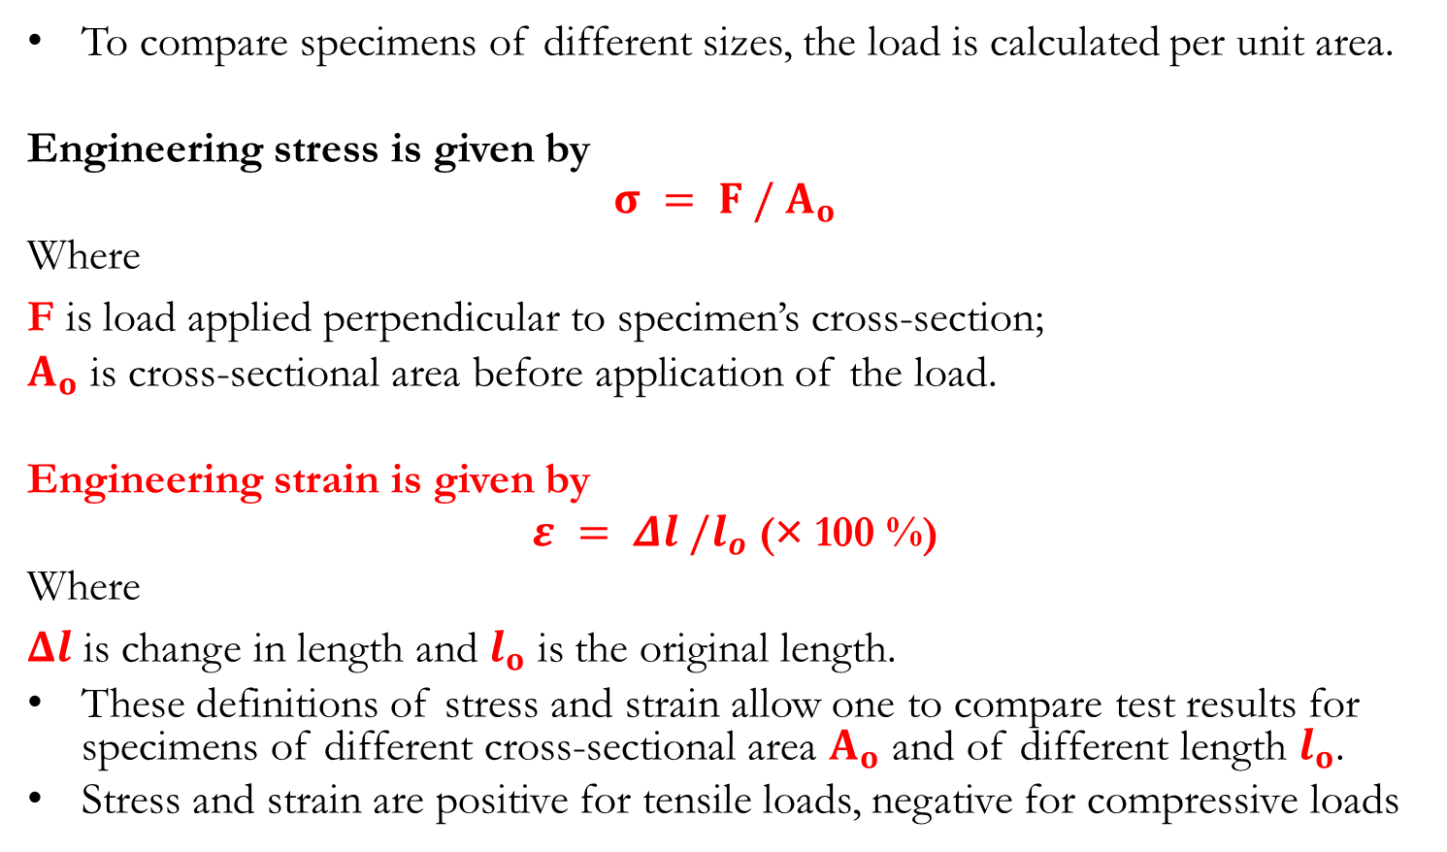
Shear and Strain (Tension and Compression)
To compare specimens of different sizes, the load is calculated per unit area.
Engineering stress is given by
$$σ = F / A_{o}$$
Where
F is load applied perpendicular to specimen’s cross-section;
$A_{o}$ is cross-sectional area before application of the load.
Engineering strain is given by
$ε = Δl /l_{o}$ (× 100 %)
Where
$Δl$ is change in length and $l_{o}$ is the original length.
These definitions of stress and strain allow one to compare test results for specimens of different cross-sectional area $A_{o}$ and of different length $l_{o}$.
Stress and strain are positive for tensile loads, negative for compressive loads

Slide 17
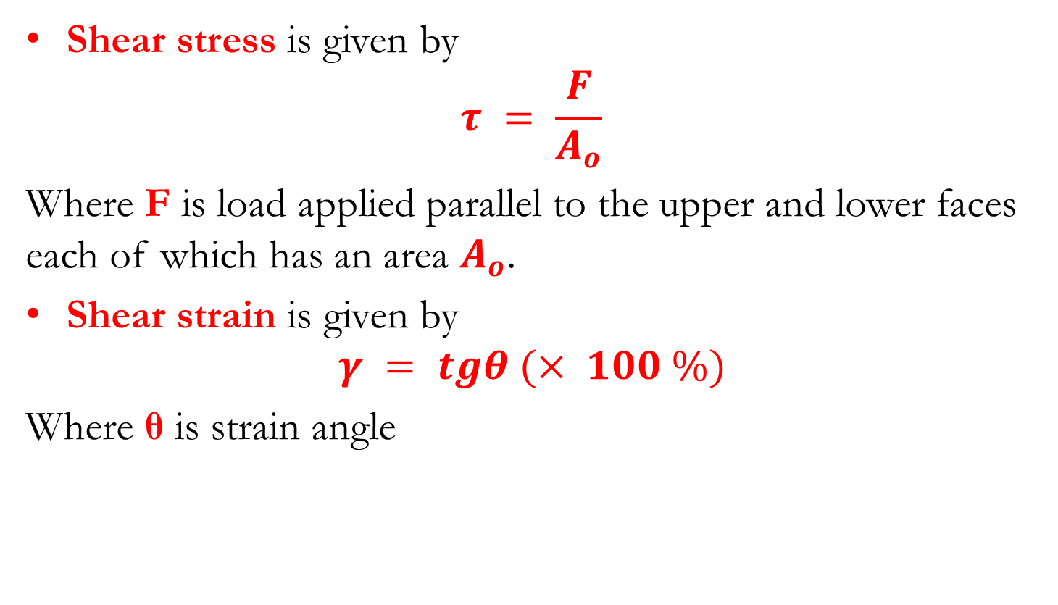
Shear and Strain (Shear and Torsion)
Shear stress is given by
$$τ = \frac{F}{A_{o}}$$
Where F is load applied parallel to the upper and lower faces each of which has an area $A_{o}$.
Shear strain is given by
$$γ = tgθ (× 100 \%)$$
Where θ is strain angle

Slide 18
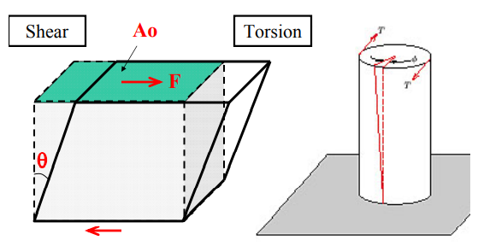
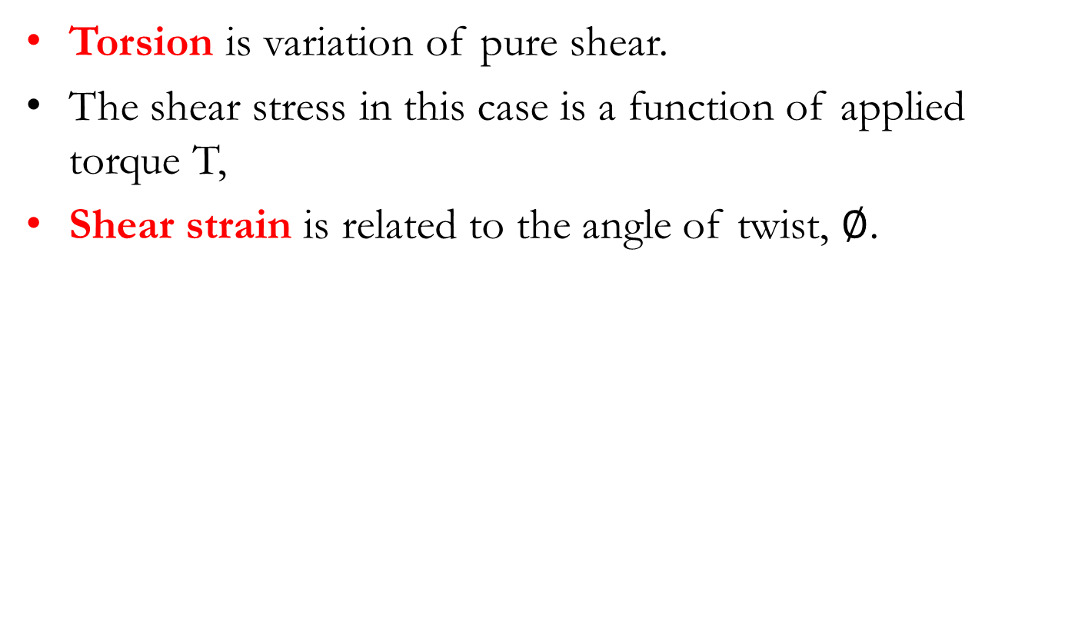
Shear and Strain (Shear and Torsion)
Torsion is variation of pure shear.
The shear stress in this case is a function of applied torque T,
Shear strain is related to the angle of twist, $∅$.

Slide 19
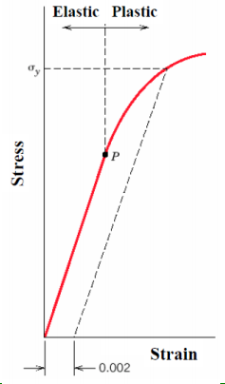
Stress-Strain Behaviour
Elastic deformation
Reversible: when the stress is removed, the material returns to the dimensions it had before the loading.
Usually strains are small (except for the case of some plastics, e.g. rubber).
Plastic deformation
Irreversible: when the stress is removed, the material does not return to its original dimensions.

Slide 20
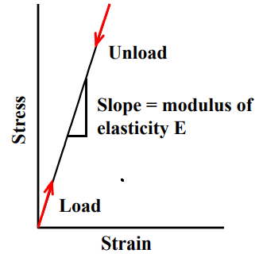
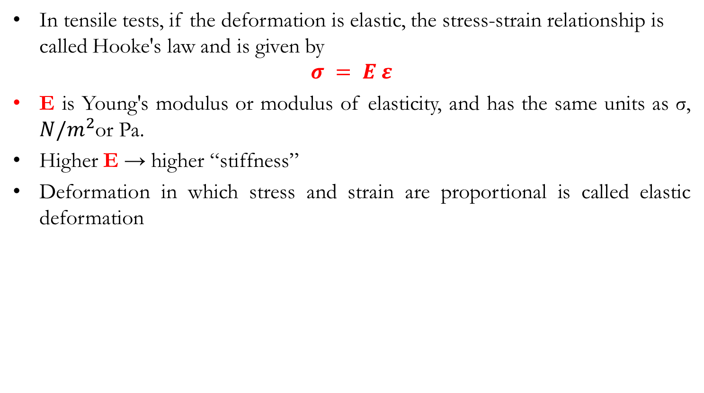
Stress-Strain Behaviour – Elastic Deformation
In tensile tests, if the deformation is elastic, the stress-strain relationship is called Hooke's law and is given by
$$σ = E ε$$
E is Young's modulus or modulus of elasticity, and has the same units as σ, $N/m^{2}$or Pa.
Higher E → higher “stiffness”
Deformation in which stress and strain are proportional is called elastic deformation

Slide 21
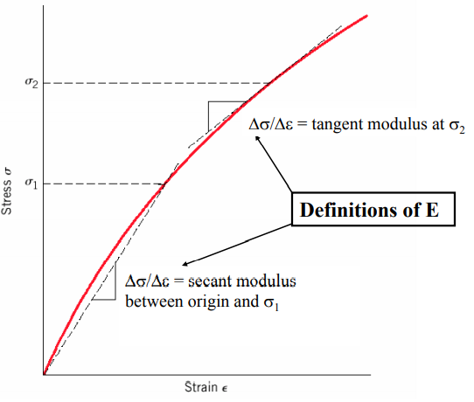
Elastic Deformation: Nonlinear Elastic Behaviour
Elastic deformation is non linear but still reversible in some materials such as polymers and concrete.

Slide 22
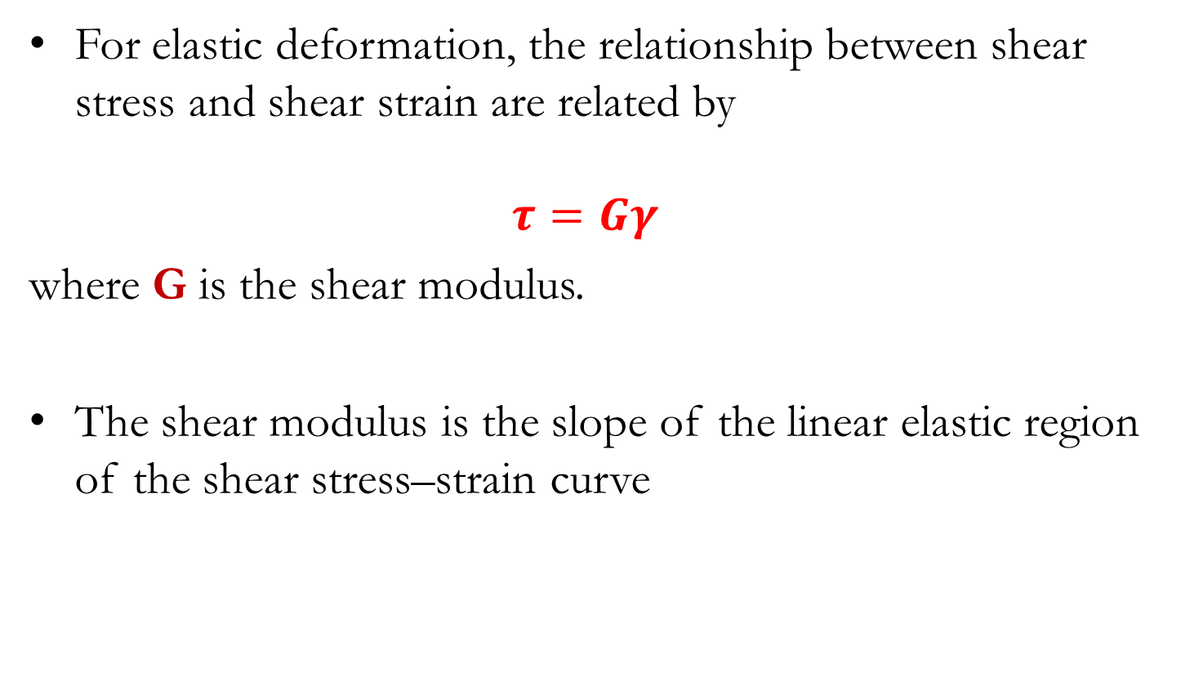
Elastic Deformation
For elastic deformation, the relationship between shear stress and shear strain are related by
$$τ=Gγ$$
where G is the shear modulus.
The shear modulus is the slope of the linear elastic region of the shear stress–strain curve

Slide 23
Elastic Deformation: Anelasticity
So far we have assumed that elastic deformation is time independent (i.e. applied stress produces instantaneous elastic strain)
However, in reality elastic deformation takes time - continues after initial loading, and after load release.
This time dependent elastic behaviour is known as anelasticity.
The effect is normally small for metals but can be significant for polymers (“visco-elastic behavior”).

Slide 24
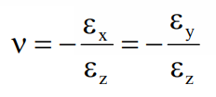
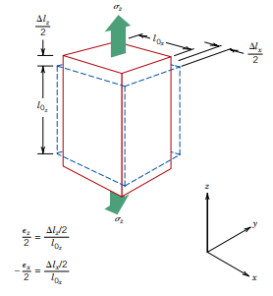
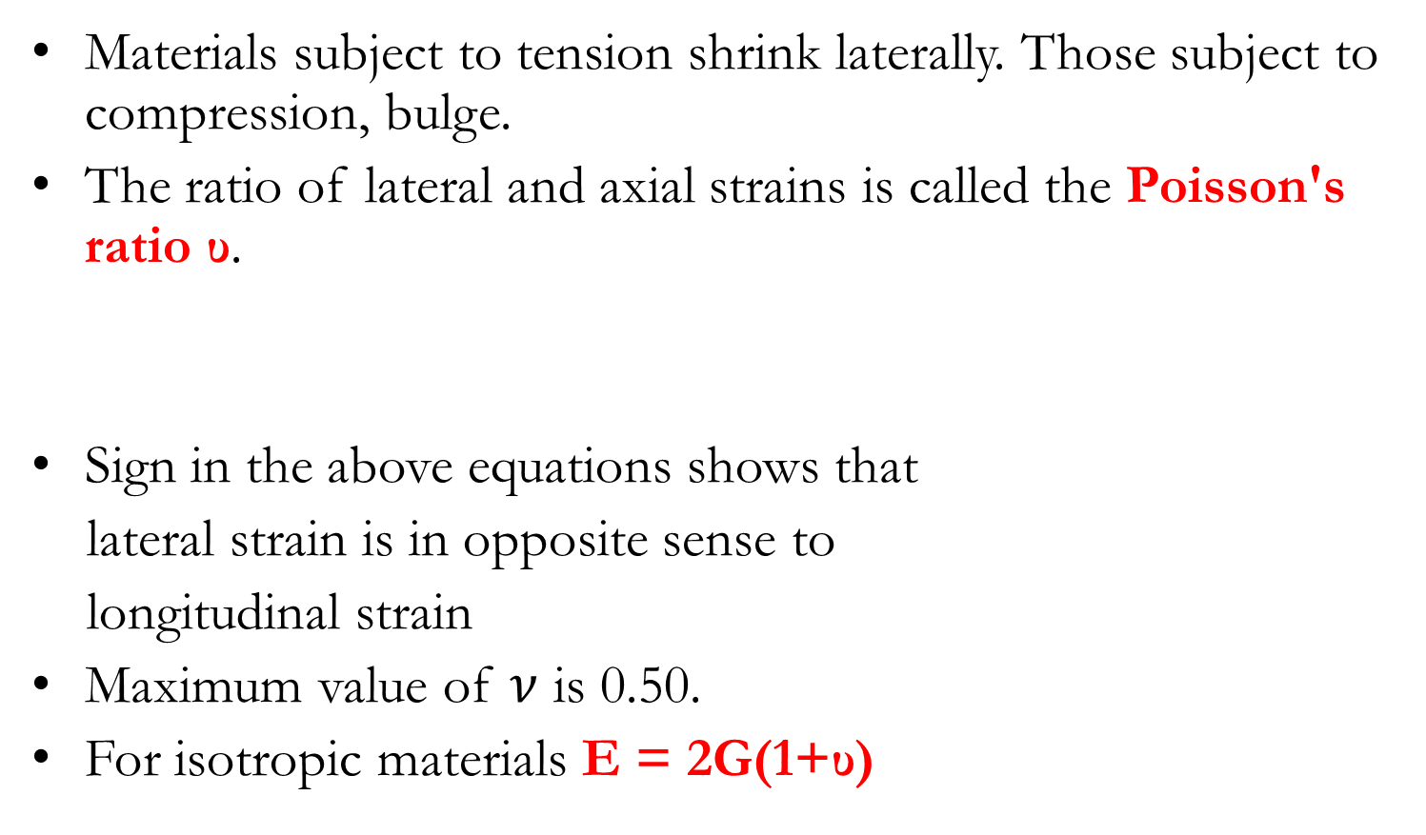
Elastic Deformation – Poisson’s Ratio
Materials subject to tension shrink laterally. Those subject to compression, bulge.
The ratio of lateral and axial strains is called the Poisson's ratio υ.
Sign in the above equations shows that
lateral strain is in opposite sense to
longitudinal strain
Maximum value of $ν$ is 0.50.
For isotropic materials E = 2G(1+υ)

Slide 25
Plastic Deformation (Stress-strain Behaviour)
For most metallic materials, elastic deformation persists only to strains of about 0.005.
As the material is deformed beyond this point, the stress is no longer proportional to strain, and permanent, non-recoverable, or plastic deformation occurs.
The transition from elastic to plastic is a gradual process for most metals.
Some curvature results at the onset of plastic deformation, which increases more rapidly with rising stress.

Slide 26
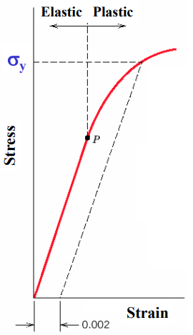
Plastic Deformation (Stress-strain Behaviour)
From an atomic perspective, plastic deformation corresponds to the breaking of bonds with original atom neighbours and then re-forming bonds with new neighbours as large numbers of atoms or molecules move relative to one another; upon removal of the stress they do not return to their original positions.
Fig. Stress-strain behaviour for a metal
showing elastic and plastic deformation

Slide 27
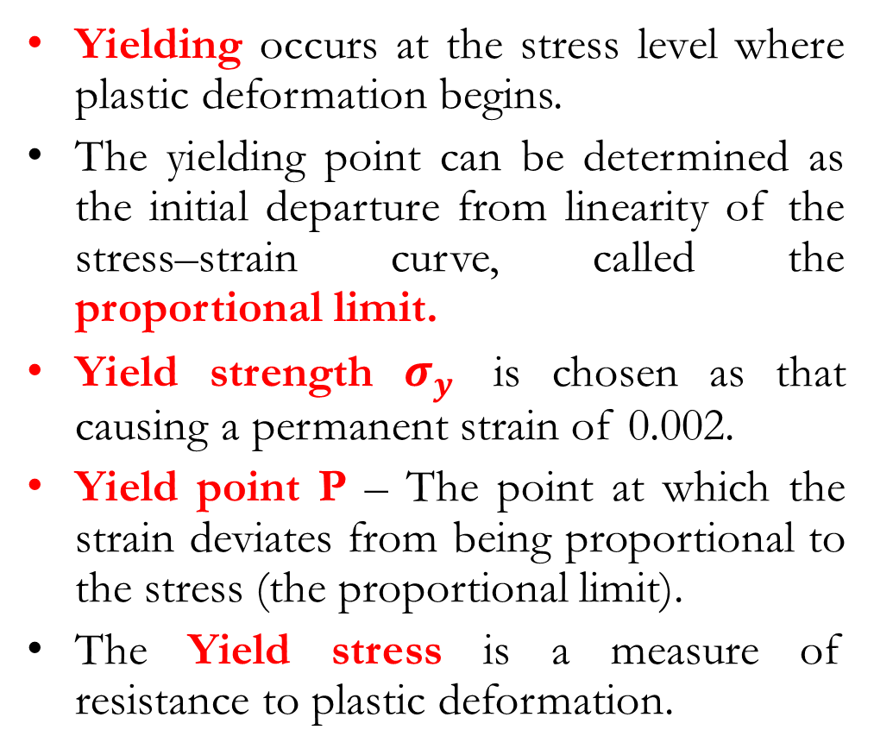
Tensile Properties – Yielding and Yield Strength
Yielding occurs at the stress level where plastic deformation begins.
The yielding point can be determined as the initial departure from linearity of the stress–strain curve, called the proportional limit.
Yield strength $σ_{y}$ is chosen as that causing a permanent strain of 0.002.
Yield point P – The point at which the strain deviates from being proportional to the stress (the proportional limit).
The Yield stress is a measure of resistance to plastic deformation.

Slide 28
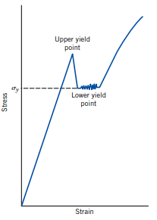
Tensile Properties – Yielding and Yield Strength
Some steels and other metals (low carbon steels) have the elastic–plastic transition occurring abruptly in a yield point phenomenon.
At the upper yield point, plastic deformation is initiated with an apparent decrease in engineering stress.
Continued deformation fluctuates slightly about some constant stress value, termed the lower yield point; stress subsequently rises with increasing strain.
For such metals that display this effect, the yield strength is taken as the average stress that is associated with the lower yield point.
The magnitude of the yield strength for a metal is a measure of its resistance to plastic deformation.
Fig. Stress–strain behaviour showing
the yield point phenomenon

Slide 29
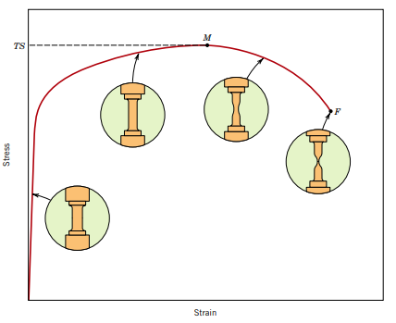
Tensile Strength
After yielding, the stress necessary to continue plastic deformation in metals increases to a maximum, point M and then decreases to the eventual fracture, point F.
The tensile strength is the stress at the maximum on the engineering stress–strain curve and it corresponds to the maximum stress that can be sustained by a structure in tension.
If the tensile strength (stress) is applied and maintained, fracture will result.
Necking begins at the tensile strength and fracture ultimately occurs at the neck.

Slide 30
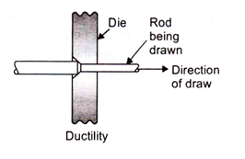


Ductility
It refers to the capacity of substance to undergo deformation under tension without rupture as in wire drawing, tube drawing operation.
Ductility is a measure of the deformation at fracture
Ductility is defined by percent elongation as
It is also defined by percent reduction in area as
For more ductile material ε_{p} > 15%, for less ductile material ε_{p} > 5.1 ε_{p} < 15%.

Slide 31
Toughness
It is the ability of the materials to withstand bending or it is the application of shear stresses without fracture.
For example, if a rod is made of high-carbon steel then it will bend without breaking under the impact of the hammer, while if a rod is made of glass then it will break by impact loading.

Slide 32
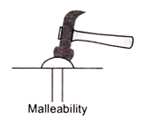
Malleability
It is the capacity of substance to withstand deformation under compression without rupture or the malleable material allows a useful amount of plastic deformation to occur under compressive loading before fracture occurs.
Such a material is required for manipulation by such processes as forging, rolling and rivet heading.

Slide 33
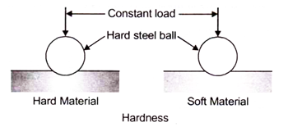
Hardness
It is the ability of a material to withstand scratching (abrasion) or indentation by another hard body, it is an indication of the wear resistance of the material.
The ball only makes a small indentation in the hard material but it makes a very much deeper impression in the softer material.

Slide 34
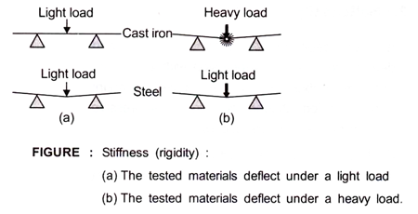
Stiffness
It is the measure of a material’s ability not to deflect under an applied load.
For example, steel is very much stronger than cast iron, then the cast iron is preferred for machine beds and frames because it is more rigid and less likely to deflect with consequent loss of alignment and accuracy.

Slide 35
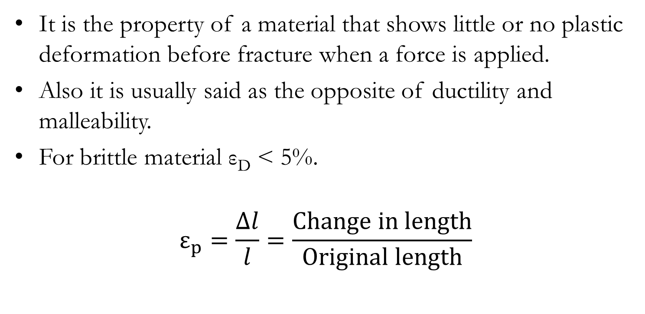
Brittleness
It is the property of a material that shows little or no plastic deformation before fracture when a force is applied.
Also it is usually said as the opposite of ductility and malleability.
For brittle material ε_{D} < 5%.
$$ε_{p}=\frac{∆l}{l}=\frac{Change in length}{Original length}$$

Slide 36
Creep
The permanent deformation (strain) of a material under steady load as a function of time is called creep.
Length of our waist belt increases after some duration, is due to creep effect.
Creep is a thermally actuated process, and hence is influenced by temperature. It is appreciable at temperature above 0.4. T_{m,} where T_{m} is melting point of material in degree kelvin.
Creep occurs at room temperature in many materials such as lead, zinc, solder wire (an alloy of Pb and Sn), white metals, rubber, plastics and leather etc.

Slide 37
Fatigue
The behavior of materials under fluctuating and reversing loads (or stresses) is termed as fatigue. This behaviour is different from that under the steady load.
Fatigue is, however, not a dynamic effect.
The rate of loading is usually not a factor of fatigue behaviour.
Fatigue behaviour is experienced by all materials whether metals, plastics, concretes, or composites.

Slide 38
Effects of fatigue
Loss of ductility,
Loss of strength, and
Enhanced uncertainty in strength and the service life of materials.

Slide 39
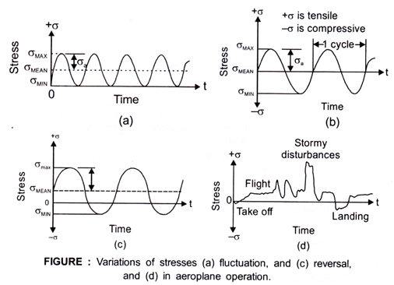
Features of fatigue
Fatigue occurs at stresses well within the elastic range. Various types of fluctuating and reversing stresses are shown in figure (a-d) in a simplified manner.
In practical situations the stress variations may be drastic, unpredictable and complex. One such example, Figure (d), is that of an aeroplane during its take-off, flight and landing.

Slide 40
Fatigue Limit (or Endurance Stress) and S-N Diagram
Total number of cycles N required to bring about fracture in a material (or its specimen) under an applied stress defines its basic fatigue life.
Fatigue life of a material is expressed in percent survival out of large number of specimens.
Generally median fatigue life is estimated at 50% survival.
Ferrous metals usually have a fatigue limit but non-ferrous metals and non-metals often do not.
Fatigue response of these materials is specified for a number of stress cycle normally 10⁷ and known as fatigue strength.

Slide 41
Critical Applications of Fatigue Bahaviour
Wings of aeroplanes and other aircrafts.
Leaf springs used on automobiles and railways rolling stocks.
Connecting rods of internal combustion engines.
Rotating shafts and machine parts.

Slide 42
Physical Properties of engineering materials
These are concerned with such properties as melting, temperature, electrical conductivity, thermal conductivity, density, corrosion resistance, magnetic properties, etc.

Slide 43
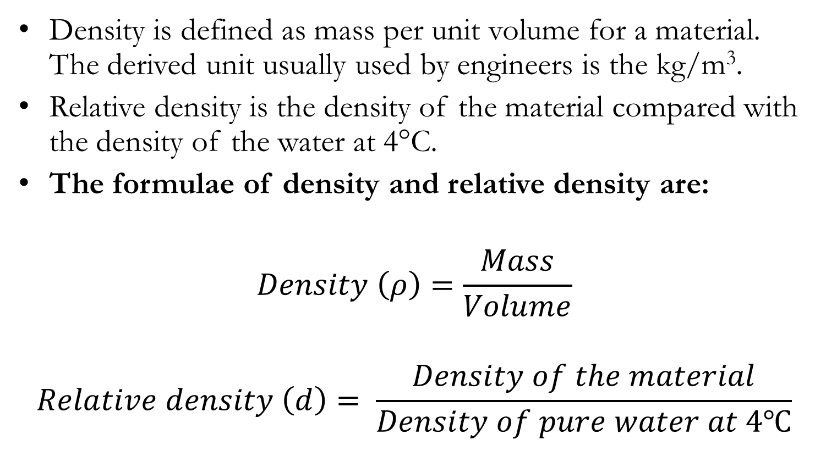
Density
Density is defined as mass per unit volume for a material. The derived unit usually used by engineers is the kg/m³.
Relative density is the density of the material compared with the density of the water at 4°C.
The formulae of density and relative density are:
$$Density \left(ρ\right)=\frac{Mass}{Volume}$$
$$Relative density \left(d\right)= \frac{Density of the material}{Density of pure water at 4℃}$$

Slide 44
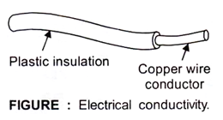
Electrical Conductivity
Figure shows a piece of electrical cable. In this example copper wire has been chosen for the conductor or core of the cable because copper has the property of very good electrical conductivity.
That is, it offers very little resistance to the flow of electrons (electric current) through the wire. A plastic materials such as polymerized has been chosen for the insulating sheathing surrounding the wire conductor.

Slide 45
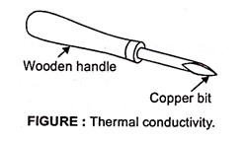
Thermal Conductivity
This is the ability of the material to transmit heat energy by conduction. Figure shows a soldering iron.
The bit is made from copper which is a good conductor of heat and so will allow the heat energy stored in it to travel easily down to the tip and into the work being soldered.
The wooden handle remains cool as it has a low thermal conductivity and resists the flow of heat energy.

Slide 46
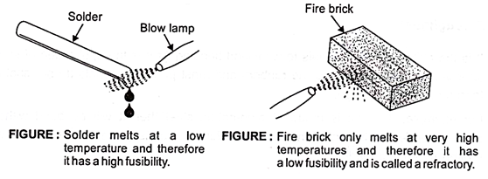
Fusibility
This is the ease with which materials will melt.
It can be seen from figure that solder melts easily and so has the property of high fusibility.
On the other hand, fire bricks used for furnace linings only melt at very high temperatures and so have the properties of low fusibility.

Slide 47
Reluctance (Magnetic Properties)
Just as some materials are good or bad conductors of electricity, some materials can be good or bad conductors of magnetism.
The resistance of magnetic circuit is referred to as reluctance.
The good magnetic conductors have low reluctance and examples are the ferromagnetic materials which get their name from the fact that they are made from iron, steel and associated alloying elements such as cobalt and nickel.
All other materials are non-magnetic and offer a high reluctance to the magnetic flux felid.

Slide 48
Material selection and Processing
The selection of the best material for a particular design is associated with the decisions of how to process the material or manufacture a part.

Slide 49
Selecting a manufacturing process
Consider the cost
Access the capabilities of a manufacturing method
Remember that appearance matters
Think of the type of materials you have
Decide whether you require automation
Do not forget the finishing needs.

Slide 50
Factors to consider when selecting a manufacturing process
Cost
Materials to be used
Quality and durability
Available skills and resources
Scalability
Time to market
Customisation and flexibility
Sustainability and environmental impact
Compliance to regulatory and standard requirements
Risk assessment

Slide 51
Case Study
You are tasked to design and manufacture a desk to be used by KNUST students. The desk needs to meet various criteria such as affordability, durability, ergonomics, and ease of assembly. To ensure the successful production of the desk, carefully evaluate different manufacturing methods and select the most suitable one.

Slide 52
Case Study cont. (Method)
Cost (Cost effective) | Durability (strong and long lasting) | Ergonomics (Comfort and safety) | Assembly (Easy and efficient assembly processes)
Material cost | Structural integrity | Adjustable features | Easy assembly steps
Labour cost | Durability | Adjustable height etc. | Simple tools
Equipment investment
Economies of scale

Slide 53
Evaluation of Manufacturing Methods
Woodworking | Sheet metal fabrication | Injection molding | Hybrid
Traditional wood working using wood. | Cutting, bending, and assembling metal sheets to form the desk structure. | Plastic manufacturing process suitable for large-scale production | Sheet metal for the desk structure and wood for the work surface
High level of customization and aesthetics. | Excellent durability, a wide range of design possibilities, and cost-effective mass production | design flexibility, cost-effectiveness, and rapid production. | could provide a balance between durability, aesthetics, and cost-effectiveness.
May involve higher material costs, longer production time, skilled labor, and may not be sustainable. | Ergonomics considerations and ease of assembly may be more challenging to achieve. | limitations in structural strength and the environmental impact of plastics

Slide 54
Selected Manufacturing Method
Hybrid Approach using metal fabrication for the desk structure and wood working for the work surface.

Slide 55
Justification
Cost-effectiveness: Sheet metal fabrication allows for efficient mass production, reducing overall manufacturing costs.
Durability: The metal frame provides sturdy support, while the wooden work surface adds warmth and visual appeal.
Ergonomics: The desk could incorporate height-adjustable features, ensuring ergonomic comfort for a variety of users.
Assembly: The hybrid approach simplifies the assembly process, as the metal structure could be pre-fabricated, and the wooden work surface could be easily attached.

Slide 56
Assignment
You have been contracted to design a food processing product, such as a blender for the Engineering Guest House restaurant. Provide a step-by-step approach for the selection of the right material for the manufacturing of the blender.

Slide 57
Thank You

